Slide 1



PLEDGE TO PROGRESS Sustainability Hackathon
Sponsored By
Your Team Name : Capgemini Bleed Green
Automated Organisational ESG KPI Monitoring, reporting system and Supplier assessment.
Your team bio : It is combination of Microsoft cloud, azure engineer and architect and sustainability subject matter experts.
Date :24/04/2023

Slide 2

Problem Statement?
Why did you decide to solve this Problem statement?
Industry Agnostic Scenario: It solves 3 problems
Customer Reporting and Dashboarding capabilities to view, validate, govern & execute Sustainability goals.
Build green solutions that address Social & Governance parameters
Extend and Integrated your existing solutions with Microsoft Cloud for Sustainability & Microsoft Sustainability Manager
Solution Name: Automated Organisational ESG KPI Monitoring, reporting system and Supplier assessment based on environmental, social and governance parameter.
Mostly, Sustainability goals management is a manual process i.e Multiple spreadsheets, documents and involves multiple stakeholders.
Outcome:
Time-consuming and error-prone process
Reporting and compliance problems
A subject matter specialist is required to set the organization's ESG goals.
Solution
Automated KPI Management for Supplier and organizational internal ESG KPI
Automated ESG KPI Data Capture from external database, company website and need to purchase database if required etc.
Priorities and Performance Management of all selected KPI’s
Reporting & Compliance – External and internal report generation
.

Slide 3
User Segment & Pain Points
Which user /advertiser segment would be early adopter of your product & why?
This solution is applicable to all the organisation and regions–Target market: CSRD compliance applicable to 49000 companies.
Focus industry MSME and SME.(Medium and small-scale industry- Automotive companies- Value/supply chain)
Why?
Regulations and customer requirements must be followed.
Their compliance is helped by the solution's automation of the internal and external reporting processes.
To adopt sustainability within the organisation, a external consultants or internal sustainability (subject matter expert) resource is required.
The selection of KPI requires extensive stakeholder participation for a rigorous procedure called materiality assessment..
Automobile manufacturers have a complicated supply chain, and our solution enables them to monitor and rank suppliers according to ESG standards.

Slide 4
Pre-Requisite
What are the alternatives/competitive products for the problem you are solving?
Competitor | SAP control tower | IBM Envizi ESG Suite | UL Solutions’ 360 Supply Chain | Salesforce Net Zero Cloud | Achilles | Ecovadis
Platform | offer end-to-end, real-time visibility across an organization’s entire network | provides comprehensive data and analytics software to collect, manage and derive insights from ESG data. | Questionnaire to gather information from suppliers to manage. | have all your data in one place, view the Carbon performance of organsiation, and reporting tools to share insights | Score/ ESG rating/ performance feedback | rating platform/ methodology and assessment model/ engement and support services/
USP | ESG and suuplier reporting , demand forecasting- what-if analysis and compare scenarios create action plan and track its execution | ESG, carbon, green building, supplier assessment. | ESG reporting, carbon, and Apply your custom scoring methodology to rate or risk categorize suppliers | Carbon reporting for organisation and product level. | Validate and audit suppliers | benchmark: with insudtry or country
ESG related | Higher visibility into the operations of the suppliers | Scope 1,2,3 and ESG reporting | Calculate supplier level impacts for any KPI of interest (e.g., water, carbon) and aggregate this up to give a total supply chain footprint | ESG parameters not available. Only carbon and no supply chain assessment capaability | ESG rating, no esg reporting for organization. | scorecard: on 4 themes, envi, labor &humarn right, ethics, sustainable procurement
gaps | ESG reporting | Demand forecasting, | Highly dependent on supplier self evaluation | , ESG Reporting, supply chain assessment | Highly dependent on supplier self evaluation | Demand forecasting, no esg reporting for organization.
Point of Difference with proposed solution | Optimum inventory levels smart alerts Run simulations of demand | Emissions management Decarbonization, Building management | Assign corrective actions and improvement plans with a record of activity | Emissions management Decarbonization | Core pre-qualification questions/ Business critical questions/ Buyer specific questions | insight: on strength and weakness news and updates: 360 live news

Slide 5
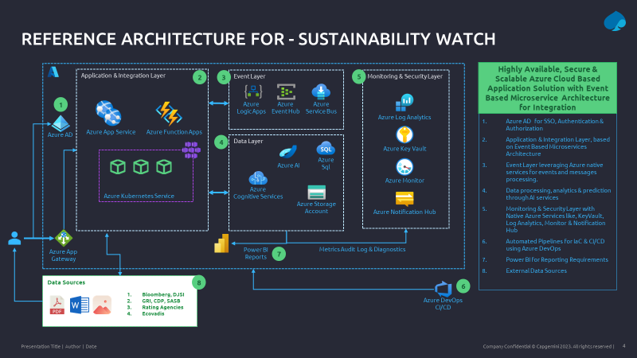
Tools or resources
Azure tools or resources which are likely to be used by you for the prototype, if your idea gets selected
Compute
App Services, Azure Functions, AKS
Data
Azure Data Factory, Storage Accounts, Azure Analytics, AI, Cognitive Services
Event Services
Service Bus, Event Hub, Logic Apps
Monitoring & Security
Azure App Insights, Key Vault, Private Endpoints, Azure AD, Notifications & Alerts
Automation
Azure DevOps – Pipelines, Dashboards
High availability – Zone Redundancy
Disaster Recovery Readiness – Multi region deployments
Automated deployments – Azure DevOps
Cost optimized – Autoscaling, Standard & Premium tiers
Sustainable – Optimized compute, auto shutdown & scale down/in rules

Slide 6
Key Differentiators
How is your solution better than alternatives and how do you plan to build adoption?
The proposed Solution have 2 modules one focuses on ESG reporting and second Supplier assessment
Sustainability ACE solution helps to Improves process efficiency by
Other competing solutions offer ESG reporting and sustainable procurement assessment capabilities, but they lack automatic target setting functionality. In comparison to competitors, the Sustainability Ace solution will be simpler to use for new users who are unfamiliar with sustainability.
Automating - Data Aggregation for selection of ESG KPI’s
Auto Assignment – Internal & External report
Cascade Goals – Internal & External
Customized Reporting – Internal & External (Audit & Compliance ready)
Realtime Dashboards - Goal status tracking & decision making
Auto Alerts –Periodic alerts and escalations

Slide 7

Any Supporting Functional Documents
Present your solution, talk about methodology, architecture & scalability
EcoVadis
Sustainability ACE - Workflow
SEDEX
ERP
Auto Ticklers
SASB
Manual
2. DATA CAPTURE (Periodic Tracking)
3. Dashboard
Power BI: Various Formats-Line chart, Bar chart ,Pie charts etc.
GRI
System Captures Data for compliance &
reporting
CDP
ESG
1. AUTO GOAL ASSIGNMENT
4. AUTO REPORTING
SASB
Compliance reporting
SUSTAINABILITY ACE
GRI
Industry Data
CDP
Past Performance
Notes:
Sustainability Pro - Software Workflow
The Platform allows Corporates to
1. Auto assign Goals using industry data, past performance, etc.
2. Data is captured and Tracked Periodically.
System can also send reminders on periodic basis automatically
3. Captured data is Displayed in a meaningful way through various Dashboards formats
4. Auto Reporting can be done in required formats like ESG, SASB, Green Bond, etc. for Audit Compliance.

Slide 8
Adoption Plan
Sustainability Ace Solution
Focus on companies who need to meet ESG compliance – for example CPRD Europe 49000 companies need to report ESG.
First timers/ beginners' companies need to comply with ESG reporting we can target.
Companies having complex supply chain
MSME or small-scale industries who don’t have much budget and skilled internal resources for ESG.
More focus on tool/solution sale rather than consulting- as process is completely automated.
How far it can go?
We can target all industries globally for ESG reporting
In future include scenario planning, net zero strategy, water stewardship, zero waste modules can be added.
Include AI capability in the solution, and Expand AI capability, cognitive search capability to automise goal selection from Competitor ESG reports.

Slide 9
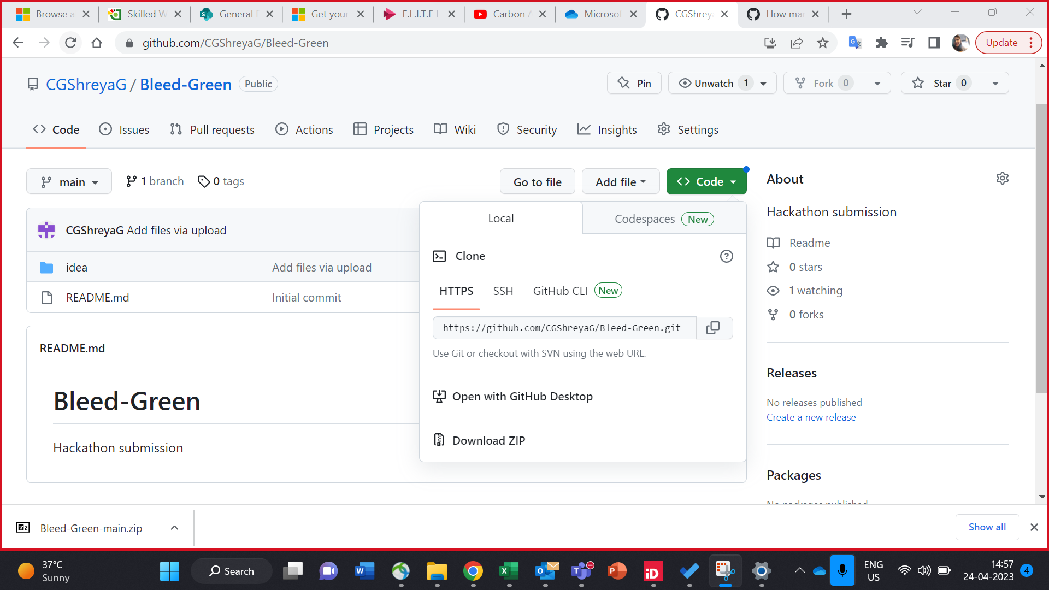
GitHub Repository Link & supporting diagrams, screenshots, if any
https://github.com/CGShreyaG/Bleed-Green/find/main

Slide 10

Thank You
Team member names:
Nilesh Dayalapwar
Nitin Desai
Tejas Vedalia
Shreya Gupta
Shikha Purbey

